Slide 1
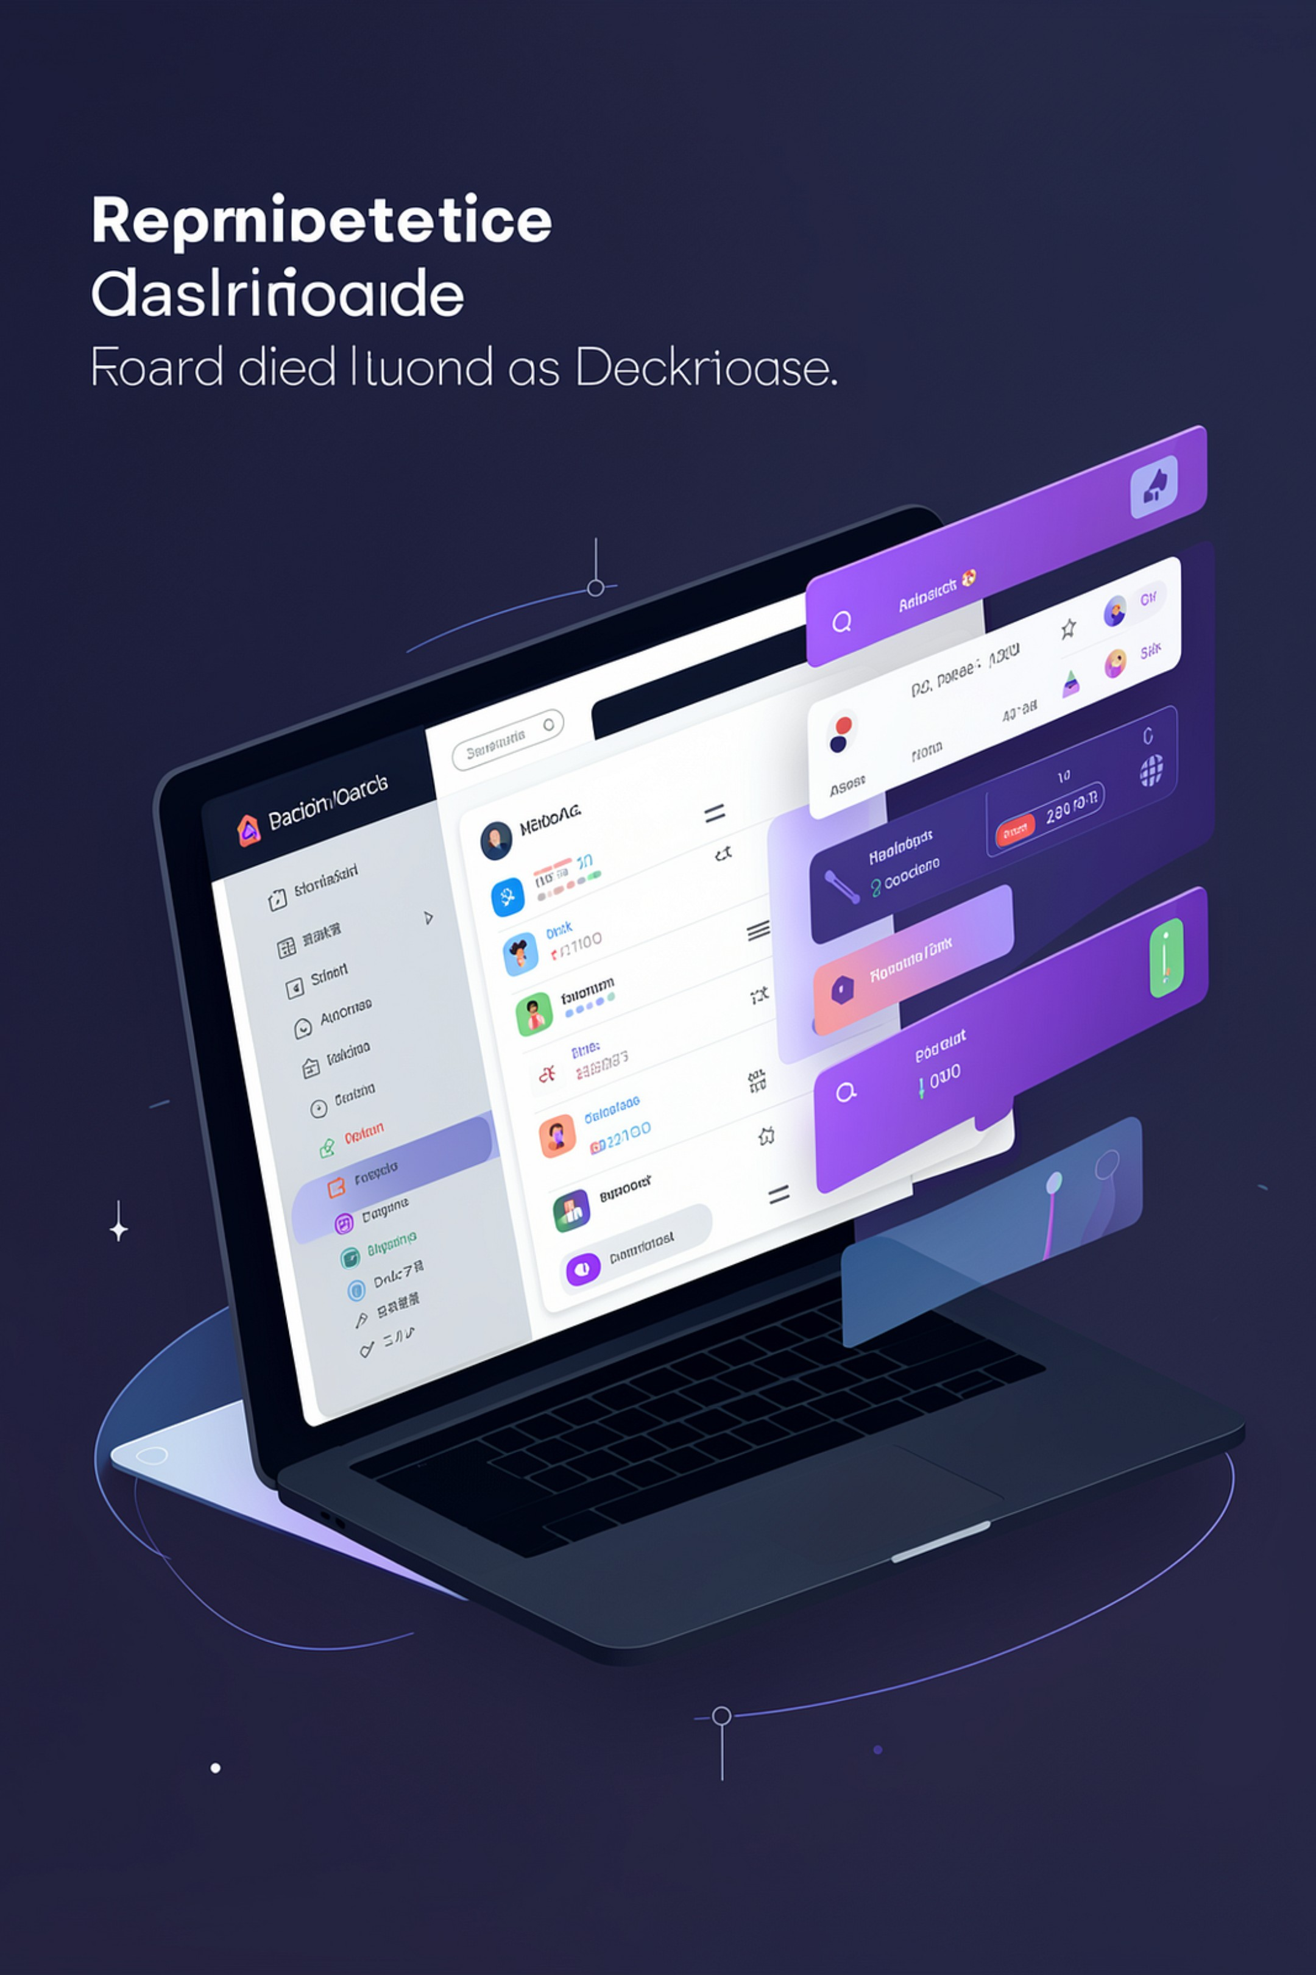

RECRUITFLOW — AI‑Powered Recruitment Management System
Streamlined hiring: fast candidate screening, structured interview management, and professional offer generation — powered by Google Gemini and a modern web stack.

Slide 2
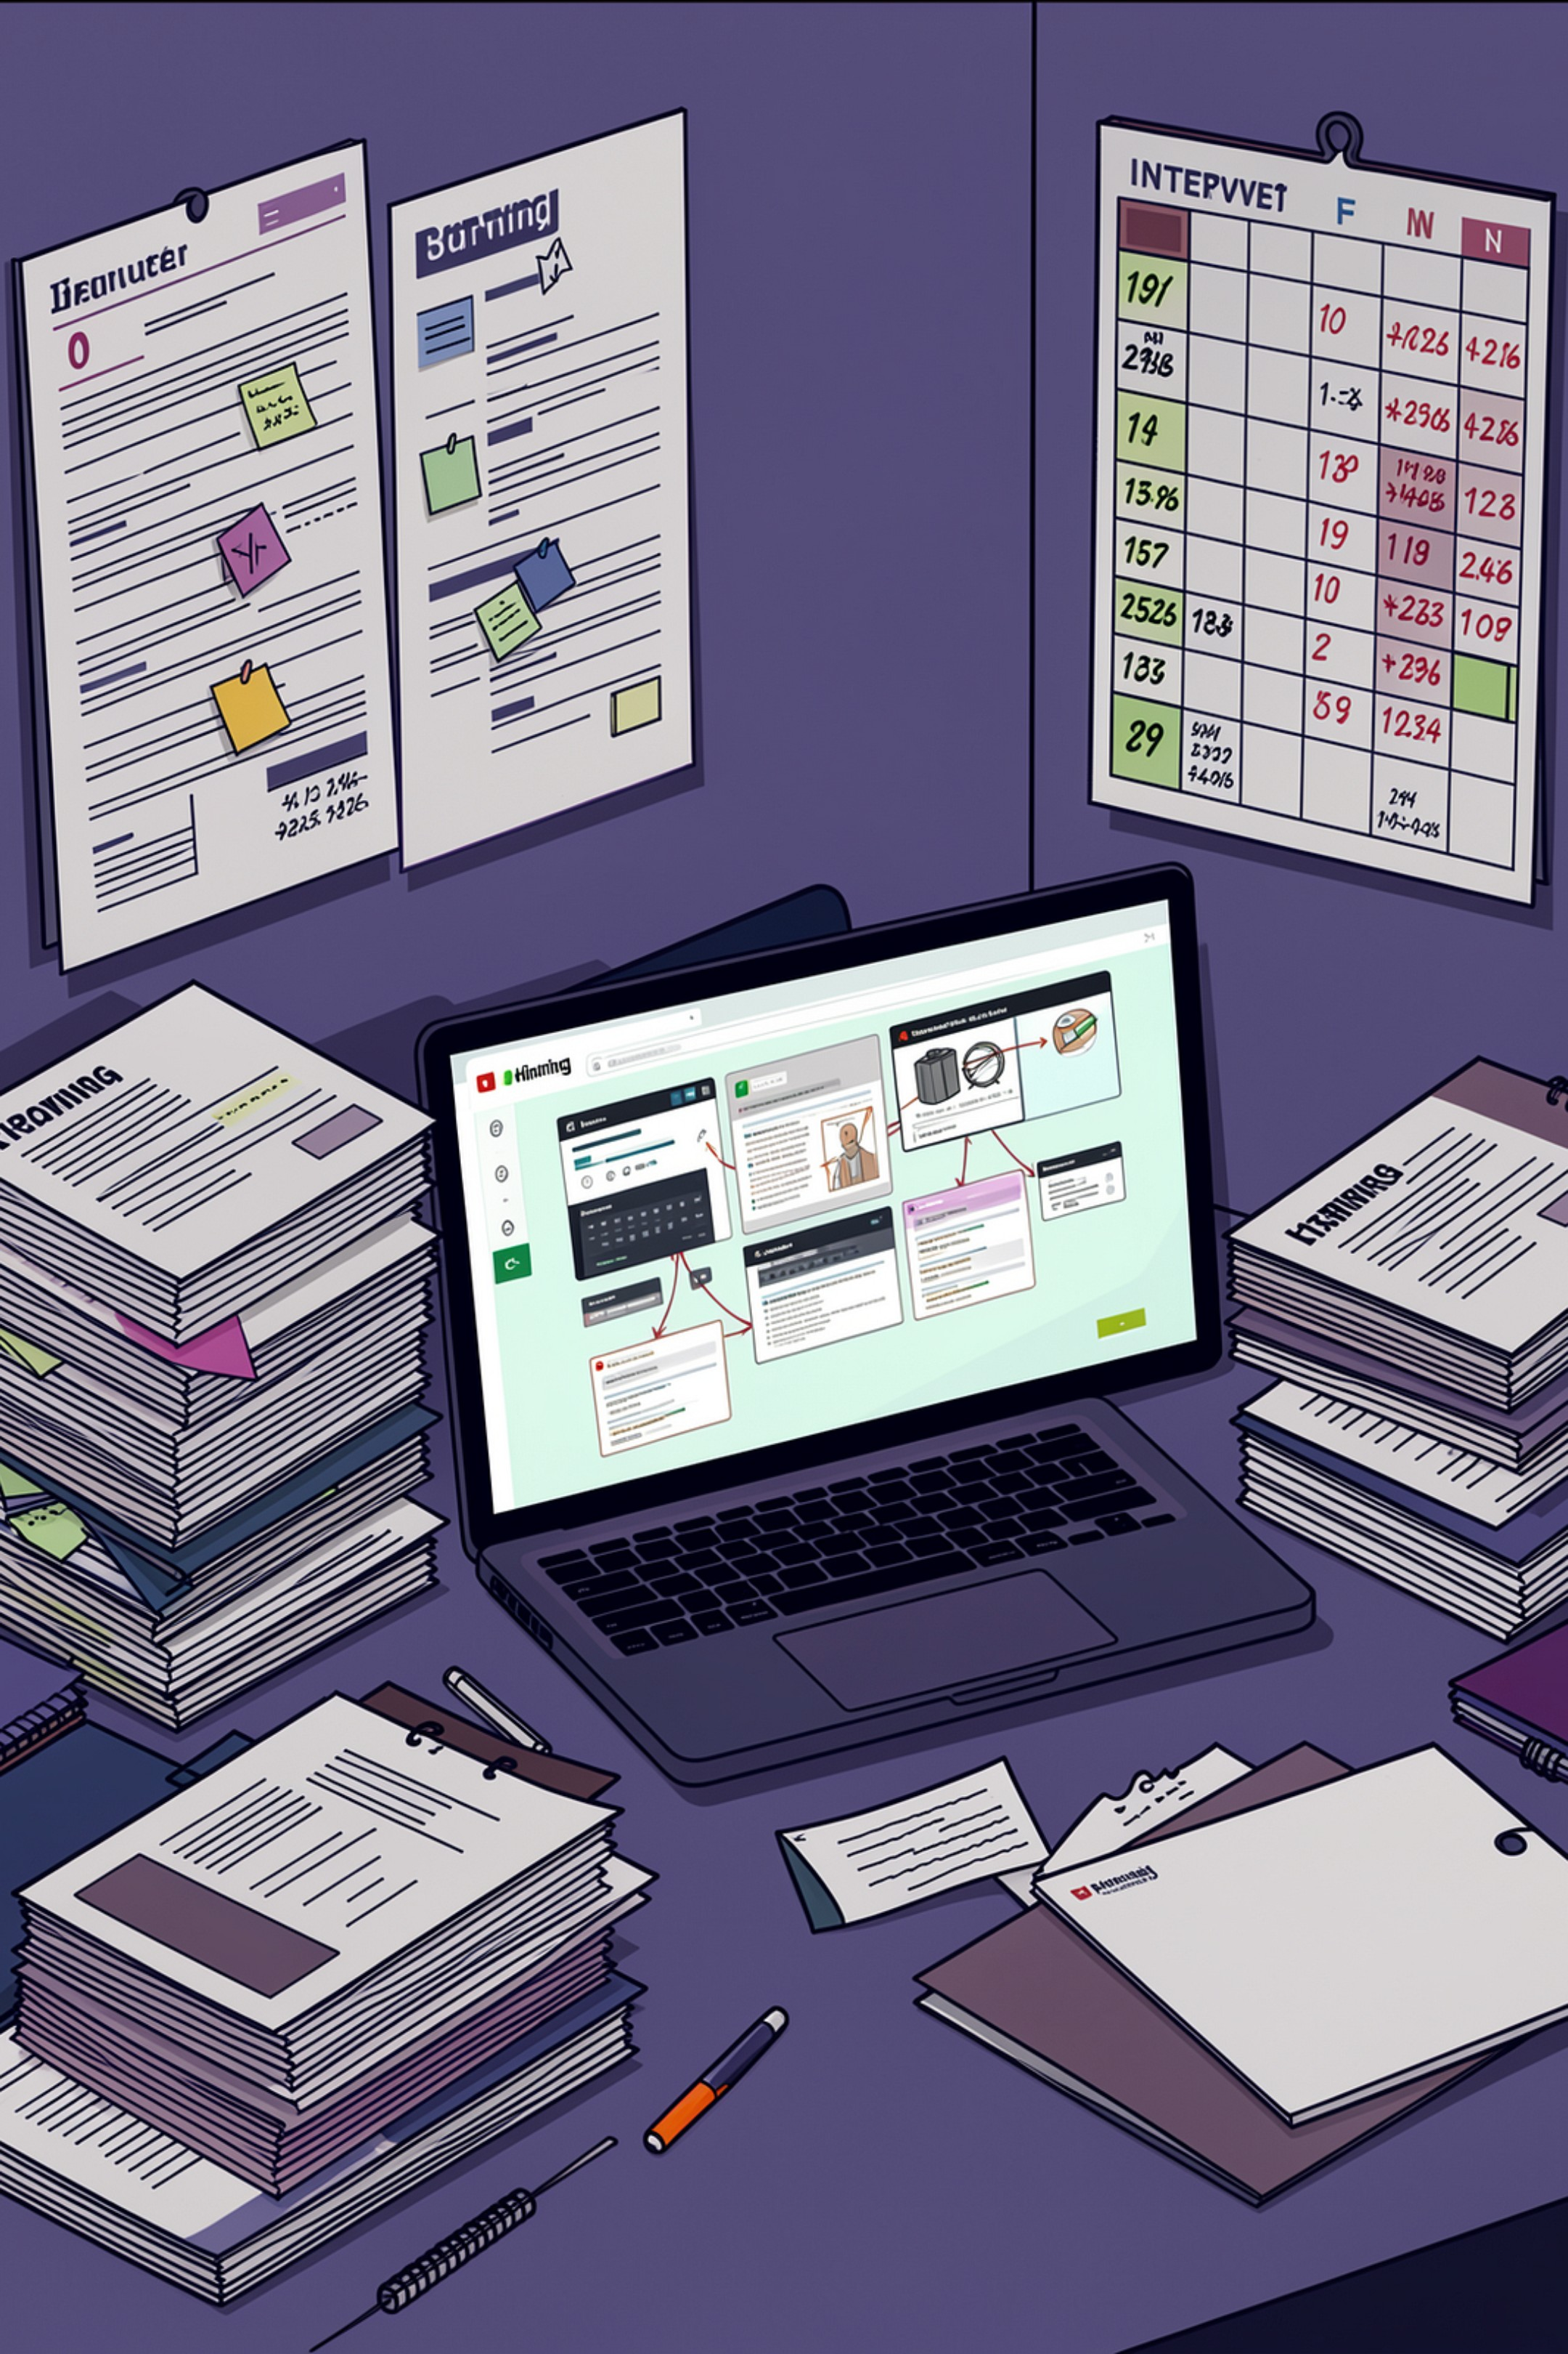

Problem Statement
Hiring teams face slow, inconsistent screening, fragmented tools for interviews and offers, and poor candidate experience. Recruiters waste time on manual resume review while qualified candidates slip through the process.
Goal: reduce time-to-hire, improve consistency, and centralize the hiring workflow.

Slide 3
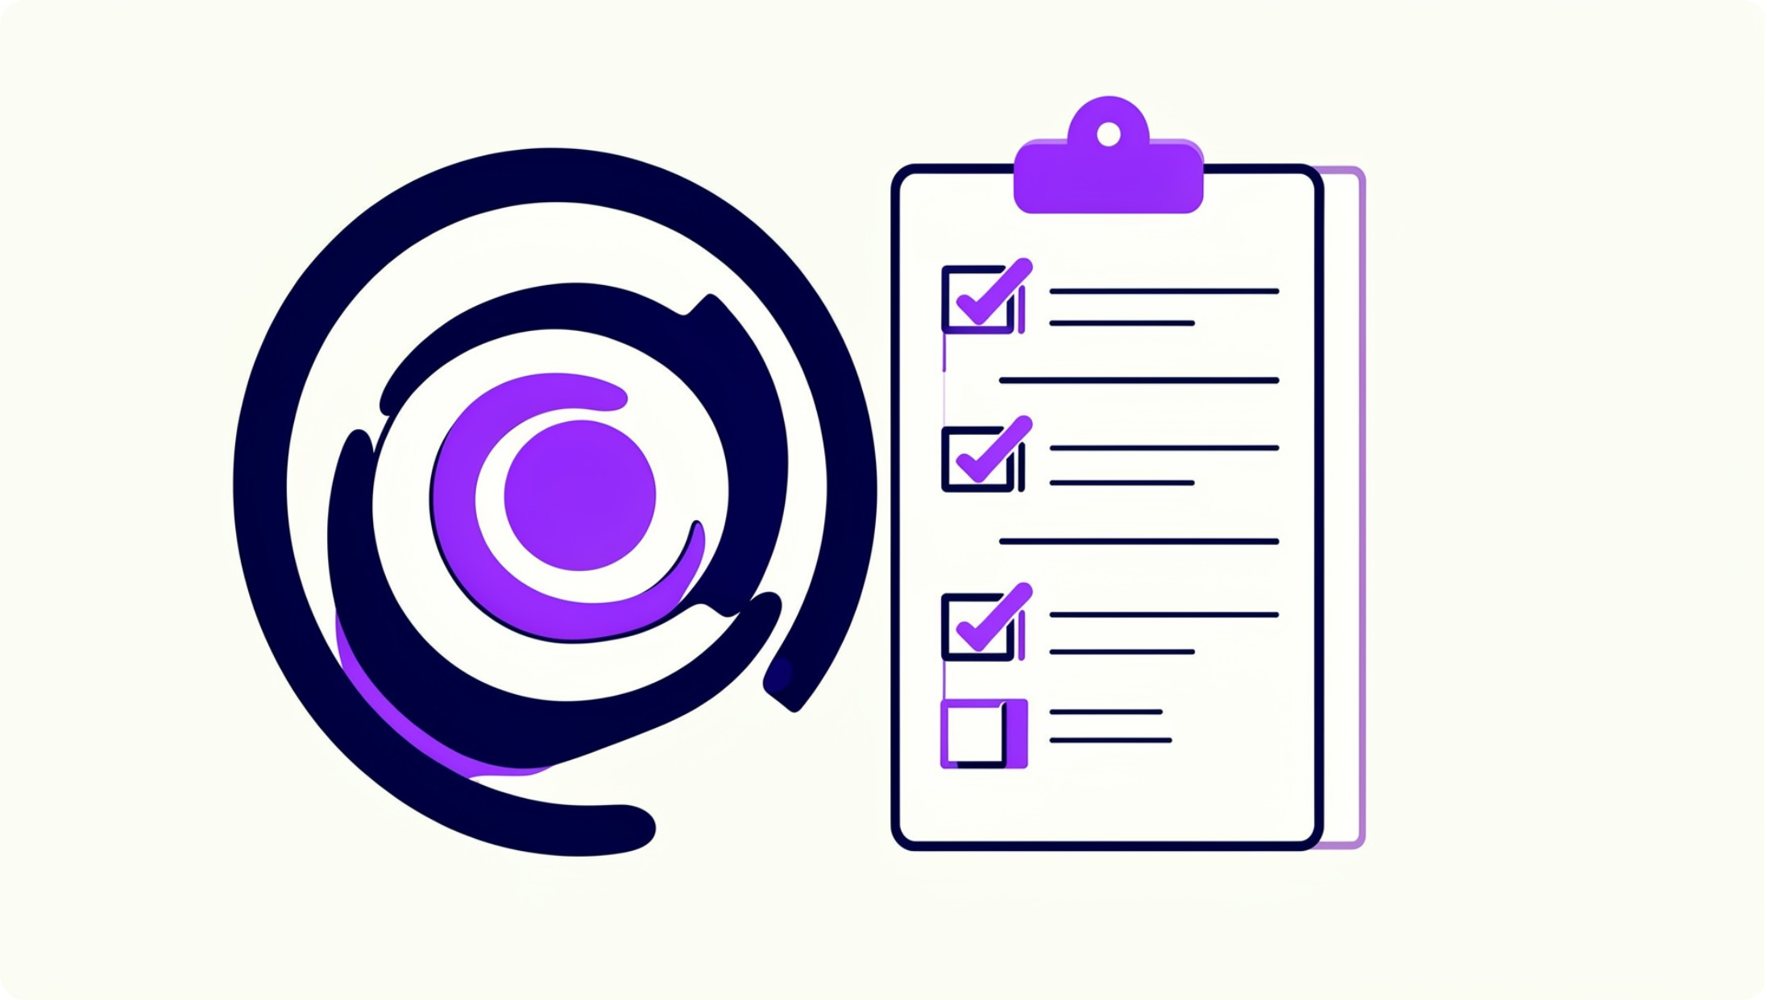
Project Objective
Automate candidate screening using Google Gemini while keeping recruiter oversight.
Provide an end-to-end, auditable recruitment workflow from application to offer.
Deliver professional, downloadable PDF offer letters and secure role-based access.
Support fast scheduling, structured interviewer feedback, and clear decision gating.

Slide 4
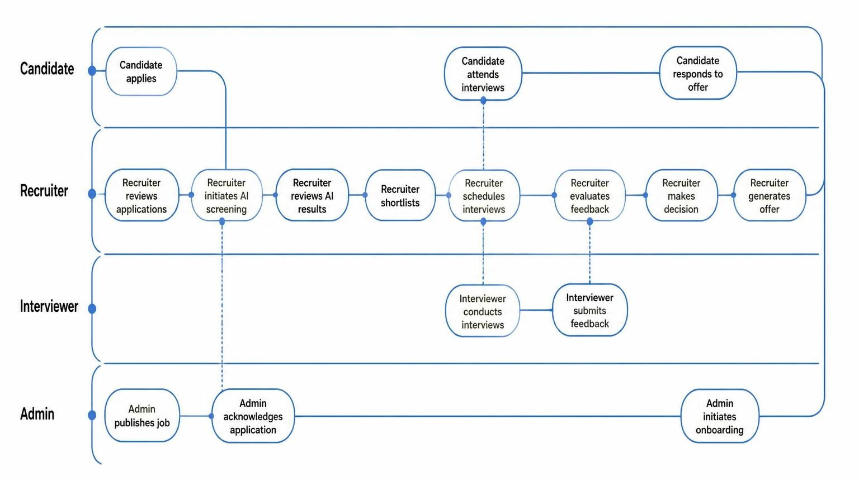
Complete Recruitment Workflow
RecruitFlow orchestrates the entire hiring journey, connecting candidates, recruiters, interviewers, and administrators through a streamlined, transparent process from application to onboarding.

Slide 5
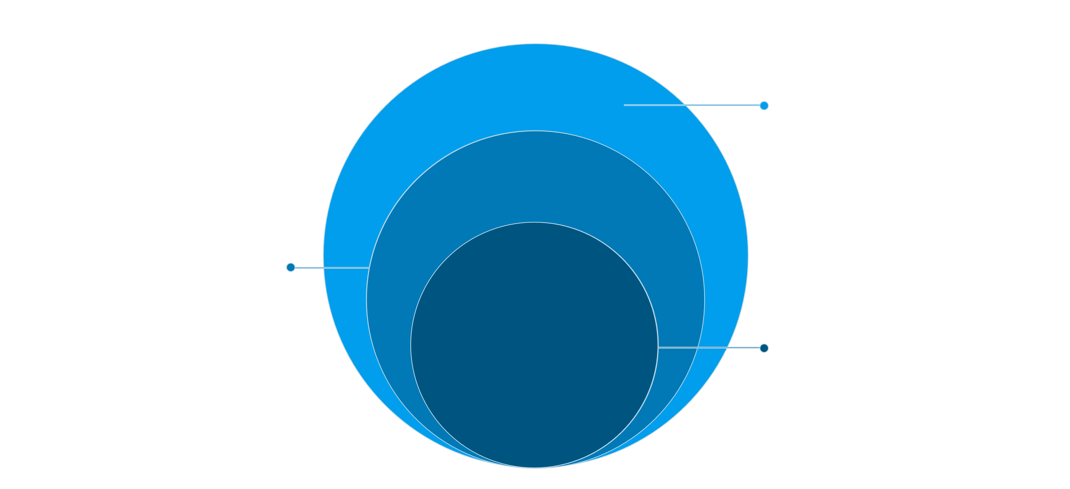
System Overview — Architecture
Data & Integrations
MongoDB + Mongoose; Gemini, PDFKit, SMTP
API Layer
Node.js + Express; JWT auth; bcrypt
UI Layer
React + Vite; Axios client requests
Modular REST API, stateless auth, and external AI & PDF services for scalability and auditability.

Slide 6




User Roles
Candidate
Recruiter
Interviewer
Admin
Register, build profile, upload resume, browse/apply jobs, view/download offer letters.
Review applications, run Gemini screening, shortlist, schedule interviews, and issue offers (final hiring decision).
Receive schedules, submit structured marks & feedback. Does NOT make final hiring decisions.
Manage roles, permissions, job templates, integrations, and audit logs.

Slide 7


Complete Recruitment Workflow
Registration
Profile
Browse Jobs
Apply
Each transition is tracked and timestamped. Recruiter retains final authority after AI and interviewer inputs.

Slide 8
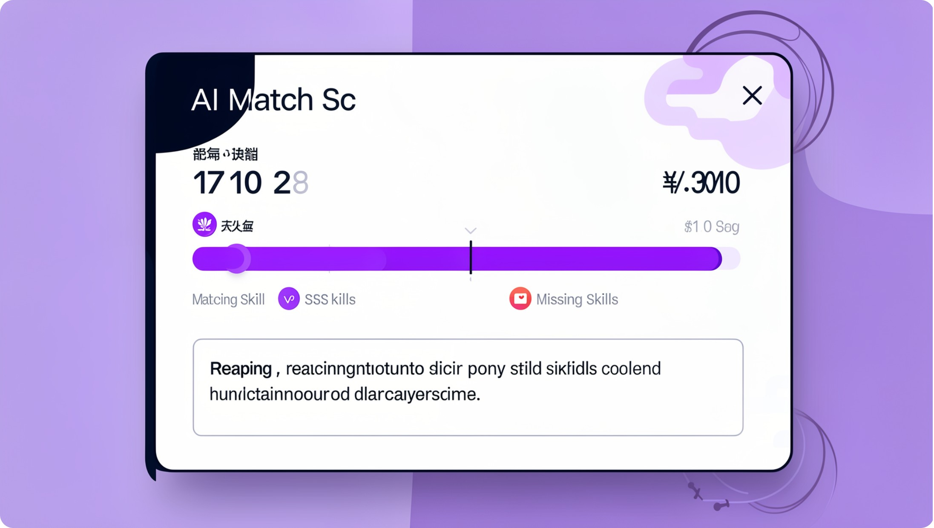
AI Resume Screening (Google Gemini)
Input: Resume + Job Description + Required/Preferred Skills
Gemini Output: Match Score, Recommendation (Strong/Consider/Low), Matching & Missing Skills, Experience & Education alignment, Strengths, Weaknesses, and Reasoning summary.
Screening is a recommendation only — Recruiter makes the final decision.
Scanner highlights critical gaps and suggests interview focus areas.

Slide 9
Application & Interview Management
Application Tracking
Interview Scheduling
Interviewer Feedback
Collaboration
Threaded comments, candidate view permissions, and consolidated feedback for recruiters.
Centralized timeline: submissions, status updates, and audit trail.
Auto-availability, calendar invites, timezone-aware scheduling, reminders.
Structured scoring template (skills, culture fit, notes) + mandatory short rationale.
Interviewer inputs inform but do not override recruiter decisions.

Slide 10
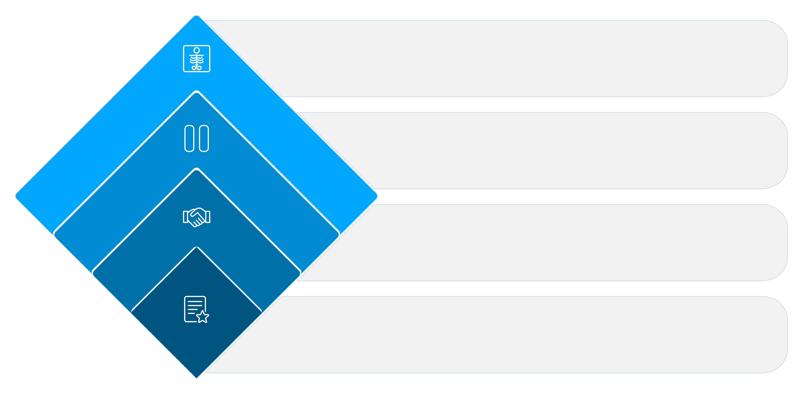
Recruiter Decision Flow
Reject
Close candidate record
Hold
Place in talent pool to revisit
Select
Generate offer and notify candidate
Post-Review
Consolidate feedback and notes
Clear gates prevent accidental offers. Hold preserves candidate metadata for future roles.

Slide 11
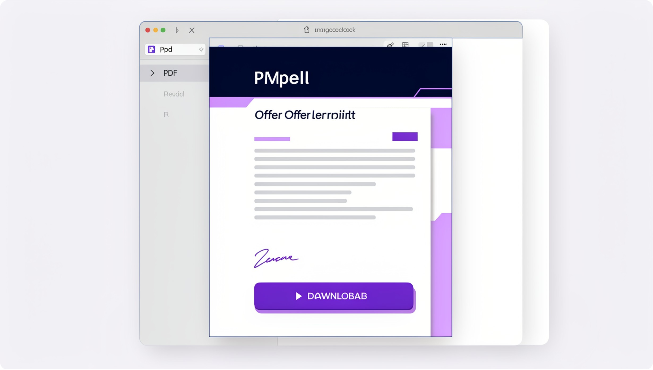
Offer Management & Professional Offer Letter PDF
Offer Workflow: Recruiter prepares offer → System validates fields → PDFKit generates branded offer letter PDF → Candidate notified (view/download) → Candidate responds (Accept / Decline / Request changes).
Offers are auditable and stored in candidate record.
Only selected candidates can receive offers.
Candidate can view & download a professional offer letter.

Slide 12

Advantages & Future Vision
Key Advantages
Increased Efficiency
Enhanced Candidate Experience
Automated screening and scheduling save valuable recruiter time.
Faster, more transparent process keeps top talent engaged.
Data-Driven Decisions
Compliance & Auditability
AI insights and structured feedback improve hiring quality.
All stages are tracked for transparent, defensible hiring.

Slide 13
Future Roadmap
Predictive Analytics
Full Onboarding Integration
Forecast hiring needs and identify talent pools.
Seamless transition from offer to employee setup.
Continuous AI Improvement
Candidate Relationship Management
Self-learning models for deeper insights.
Nurturing passive candidates proactively.

